Slide 1
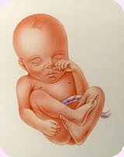
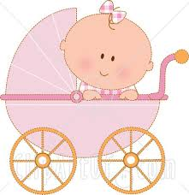
Babies and Birth
Year 6

Slide 2
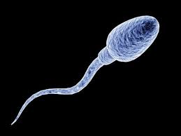
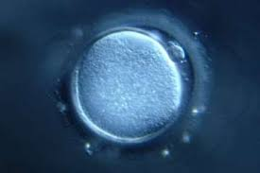
How babies are made……
Sperm cell (Male)
Egg Cell (Female)

Slide 3
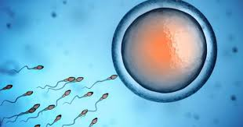
Sperm swim towards an egg

Slide 4
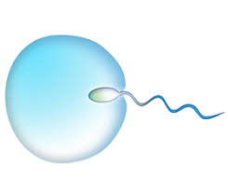
Only one sperm survives and fertilises the egg

Slide 5
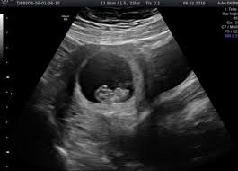
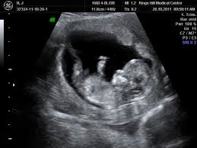
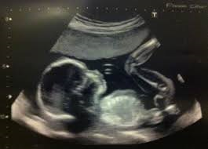
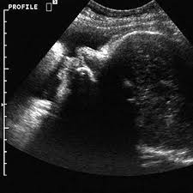
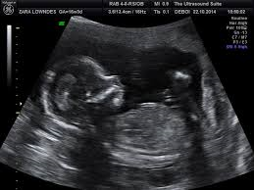
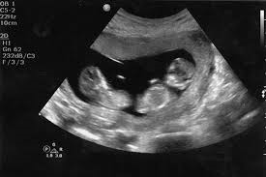
Cells merge together to make a baby…

Slide 6
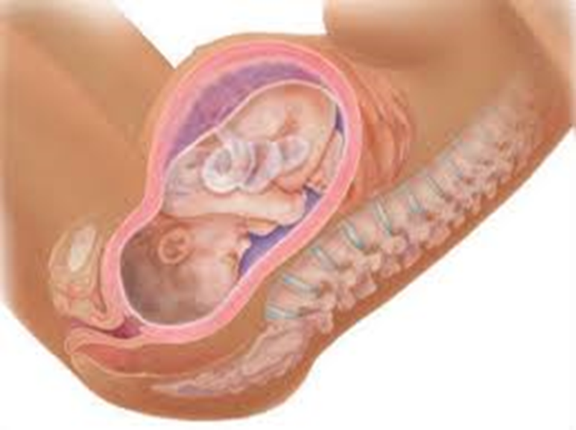
Baby in the womb
A baby is called a foetus inside it’s Mother.
The foetus grows for 9 months (40 weeks) inside the womb and is fed by the umbilical cord

Slide 7
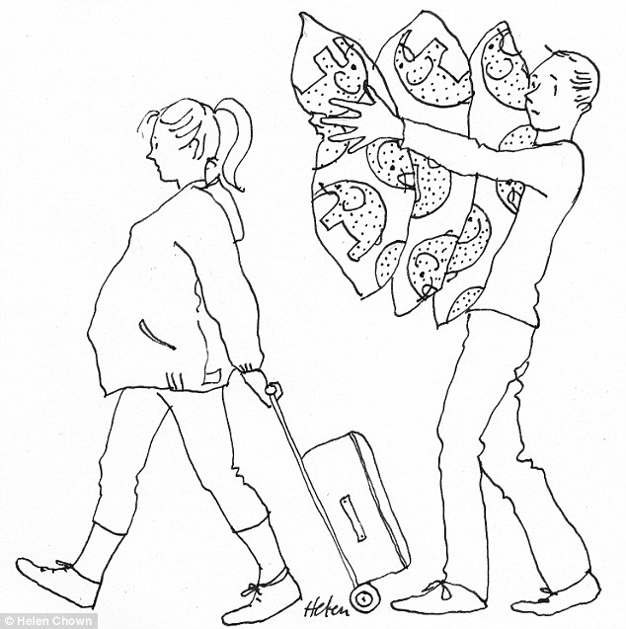
Places to have birth
Some women choose to have their baby in hospital.
Other women prefer to have a baby in a midwife led unit.
Some women prefer a home birth

Slide 8
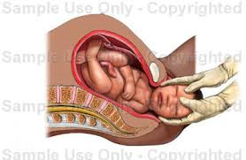
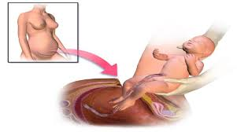
Birth
Vaginal Birth
Caesarean Birth

Slide 9

Building for a baby!
Having a baby changes your life. On the post it note draw and label something that a new baby will need.

Slide 10


Slide 11
Question One
The Vagina opens naturally to 8cm so that the baby can be born?

Slide 12
Question Two
A baby grows inside it’s Mother’s womb for 7 months.

Slide 13
Question Three
A baby is called a foetus while it is still inside the womb?

Slide 14
Question Four
Babies are always born in hospital?

Slide 15
Question 5
If a baby is born under water it is still able to breathe?

Slide 16
Question 6
The umbilical cord is attached to baby and Mom’s bladder?

Slide 17
Question 7
There is only one way a baby can be born?

Slide 18
Question 8
The placenta also comes out of the mother once the baby is born?

Slide 19
Question 9
Babies need a bath as soon as they are born?

Slide 20
Question 10
Babies cry as soon as they are born?

Slide 21

Questions?????????

Slide 22
https://www.youtube.com/watch?v=GE_lI86boUU

