Slide 1

A warm welcome to
Wylde Green Primary School
Open Day
for Reception places in
September 2027
Mrs Kate Kelly
Deputy Headteacher

Slide 2
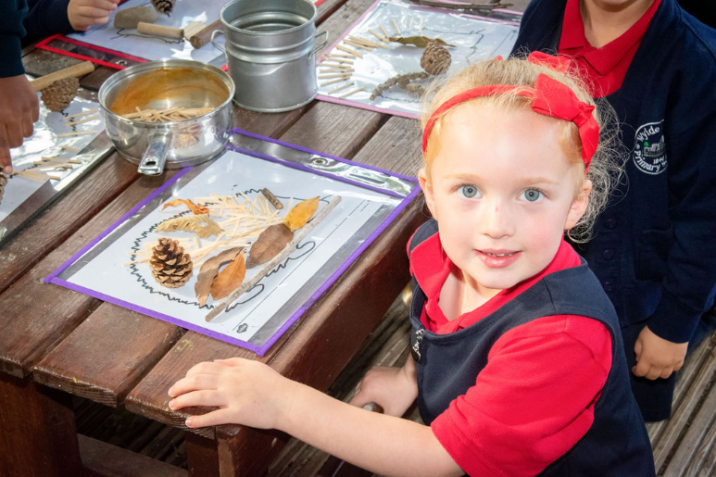
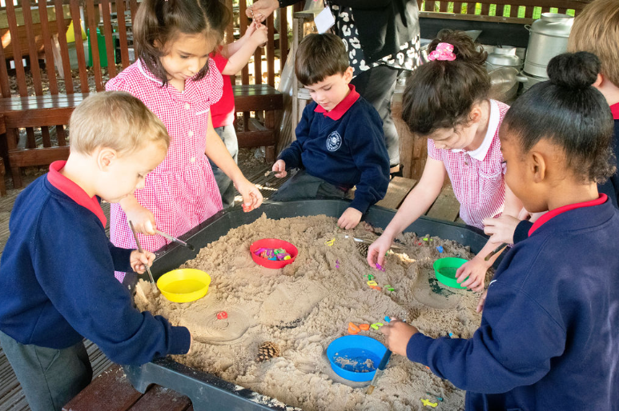
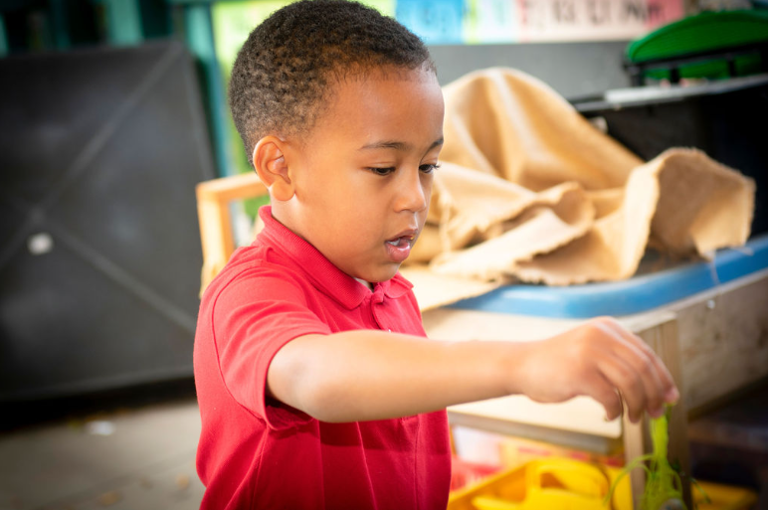
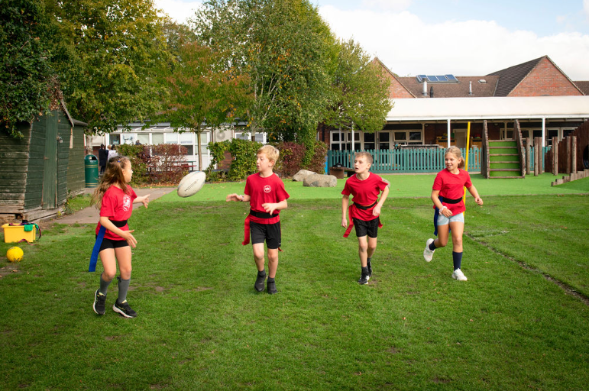

Slide 3
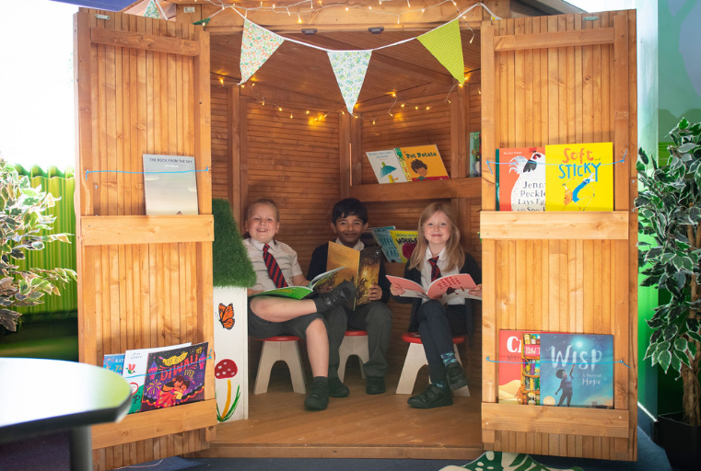
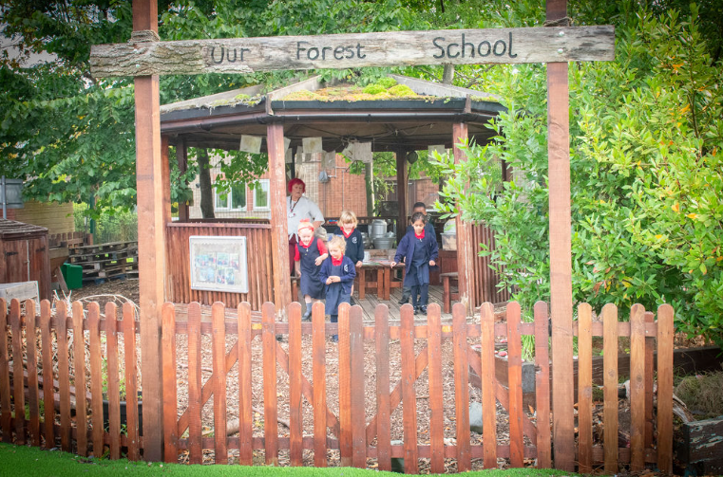
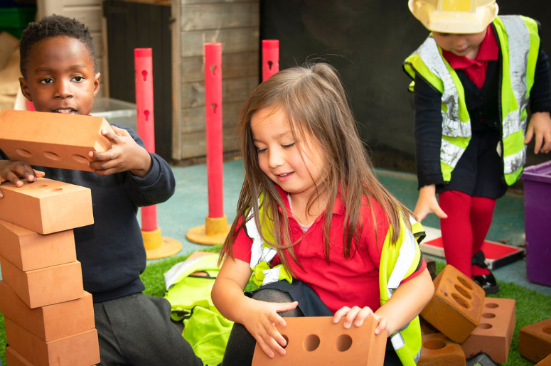
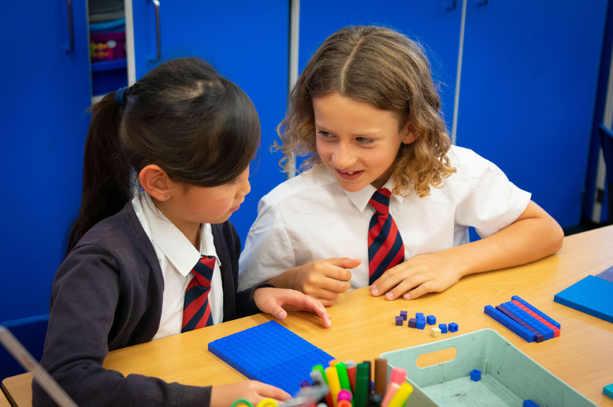

Slide 4

The Wylde Green Way
Wylde Green Vision
Wylde Green Values
At Wylde Green Primary School, we have a relentless drive for improvement and an unwavering commitment to providing high quality educational opportunities for children from Reception to Year 6. We believe that all children can achieve and we recognise that we provide the roots in their education so they can blossom on their lifelong journey of learning.
We aim to do this by providing a supportive and caring environment, rooted in high-quality teaching and learning, grounded by impeccable conduct.
Have Belief in ourselves
Be Resilient
Achieve our best
Be Nice to each other
Challenge ourselves
Be Happy

Slide 5

Our Wylde Green family…
There are 60 places on offer each year, which means there are 2 classes per year group.
We are a community school: this means we are state-funded. The local education authority employs the school's staff, and is responsible for the school's admissions and owns the school's estate.
We achieve high standards, beginning when children start school to when they leave in year 6.
Dolce provide our lunches, which enables parents to select their child’s meals at home.
Our PTFA raises a significant amount of money each year.
We have a governing body that is focussed on improving outcomes for all pupils by providing support and challenge.
We invite children and parents to attend informal ‘Stay and Play’ sessions throughout June and July.
During the Summer term, Wylde Green staff visit nurseries to meet the children who will be starting school in September.
In July, children and parents spend half a day with their new class teacher and some of their new classmates. This is an opportunity to find out about the school routines and become familiar with the environment.
In September the children are integrated over three days, 20 children at a time, starting with the youngest children. By day four, all of our Reception children are full time.

Slide 6

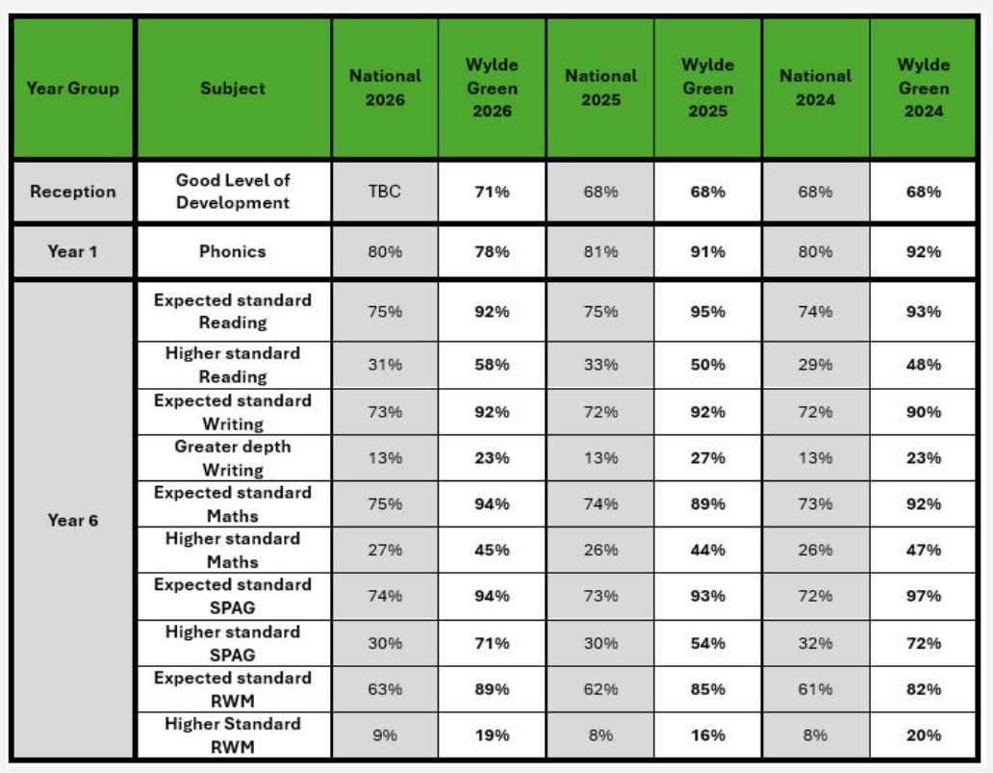
Achievement

Slide 7
At Wylde Green Primary School
Why children love being at Wylde Green…
We are proud of…
Children feel very safe at our school and are nurtured and cared for exceptionally well.
Children learn exciting and interesting things through our engaging curriculum, both indoors and outdoors at Wylde Green Primary.
Children are given the opportunity to make important decisions about how our school is run within the School Council. They can also choose to become play leaders and act as buddies to the Reception children. In Year 6, children can become Head or Deputy Head Boy or Girl, as well as House Captains.
Children’s behaviour is excellent and they are encouraged to become independent, caring and responsible citizens.
Parents and teachers work together as a team.
Children and parents make lots of friends within our school community.
Our truly unique school, originally built in 1840, now blends with brand new facilities.
The school is well-maintained with regular investment in the site’s facilities.
Our unique outdoor play area - our ‘Jungle Gym’ and Reception play area.
Working with other local schools on local and national initiatives.
Our Sports Coach and Senior Learning Mentor who provide support beyond the classroom.
Our range of clubs, such as football, rugby, gymnastics, tennis, netball, dance, art and craft, athletics and cricket.
Our Before & After School provider – ‘Wylde Cats’, who provide care for our children from 7.25am until 6:00pm.

Slide 8
Applying for a school place
Apply for a Reception school place directly to the Local Authority.
You will receive an application pack through the post during the Autumn term of the year prior to your child starting school in September.
Applications opened 1st October 2026.
The deadline for applying is 15th January 2027.
You can apply online at www.birmingham.gov.uk/schooladmissions
You will learn which school your child has been allocated via email on 16th April 2027.

Slide 9
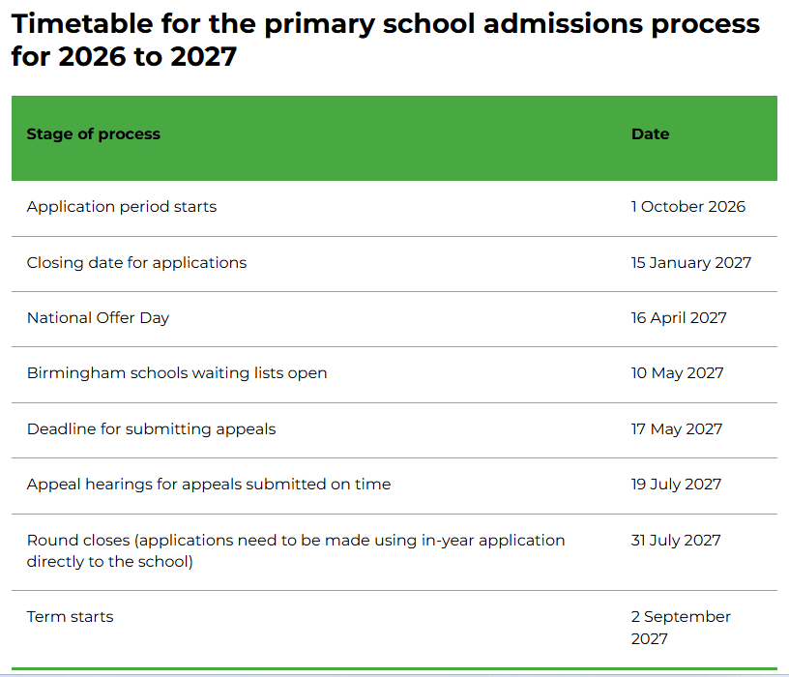


Slide 10
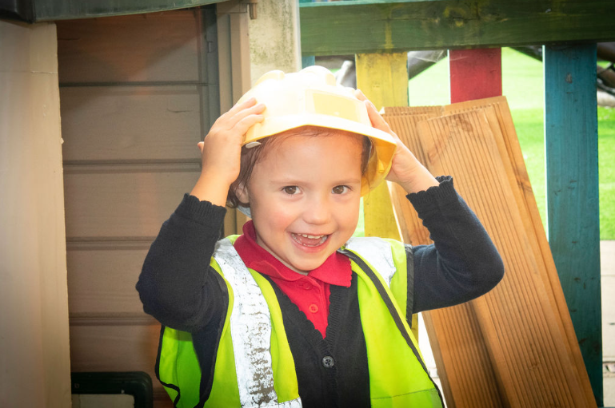
Thank you for visiting us
Take time to explore our informative website: www.wyldegrn.bham.sch.uk
Please enjoy a tour around school with our greatest advocates - our children.
Remember to visit our Reception classrooms and outdoor play areas. Our staff will be happy to answer your questions. You can also experience what a morning at Wylde Green Primary School is really like.

